Slide 1
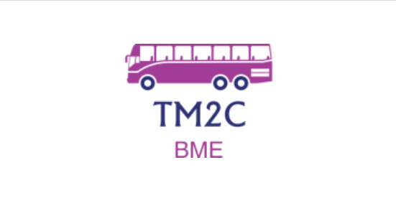
TAKE ME TO CLASS
PROGRESS REPORT
Darío Fernández Cortés
Pedro Javier Rodríguez Vílchez
Pablo Roas Domingo
Carlos Sánchez Páez

Slide 2
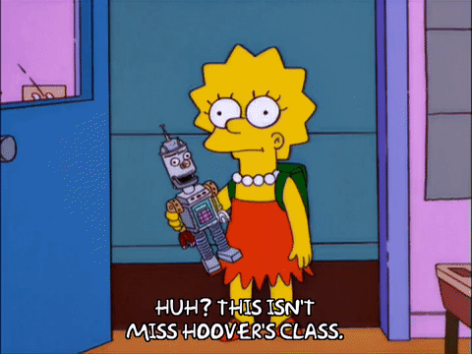

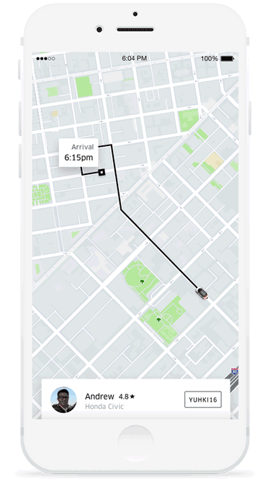
Do you remember?
-App that helps you find your class
Notes:
WHat is it TM2C?
after asking you, we see that the problem of the name of the clasess

Slide 3
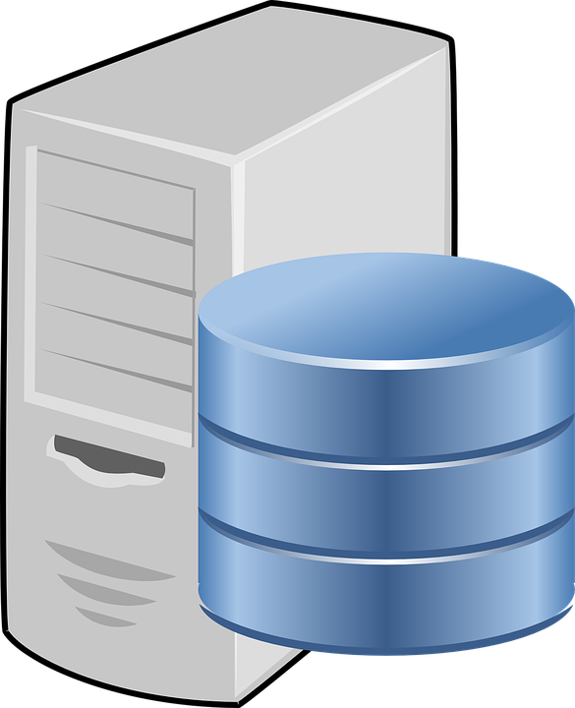



Improvements
(Conception Change)
Now:
-Server
(MySQL Database)
Firstly:
-data storage locally
Notes:
Login desde cualquier dispositivo

Slide 4


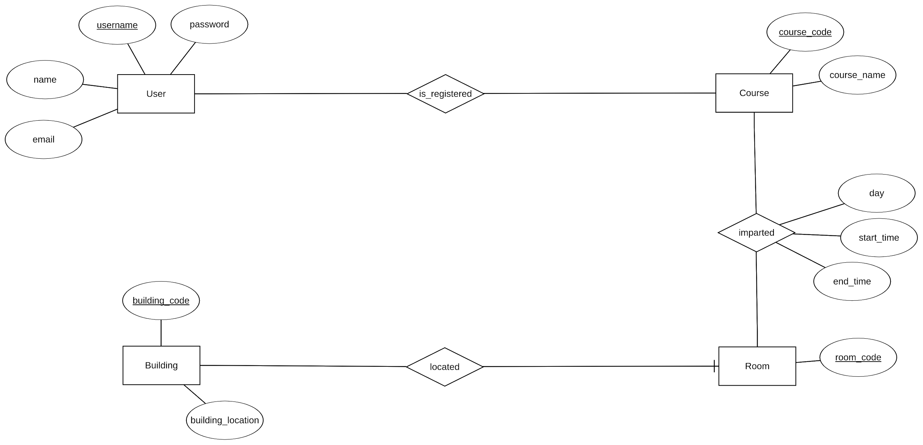


Entity-Relationship Model
Notes:
4 entidades que se relacionan ...

Slide 5
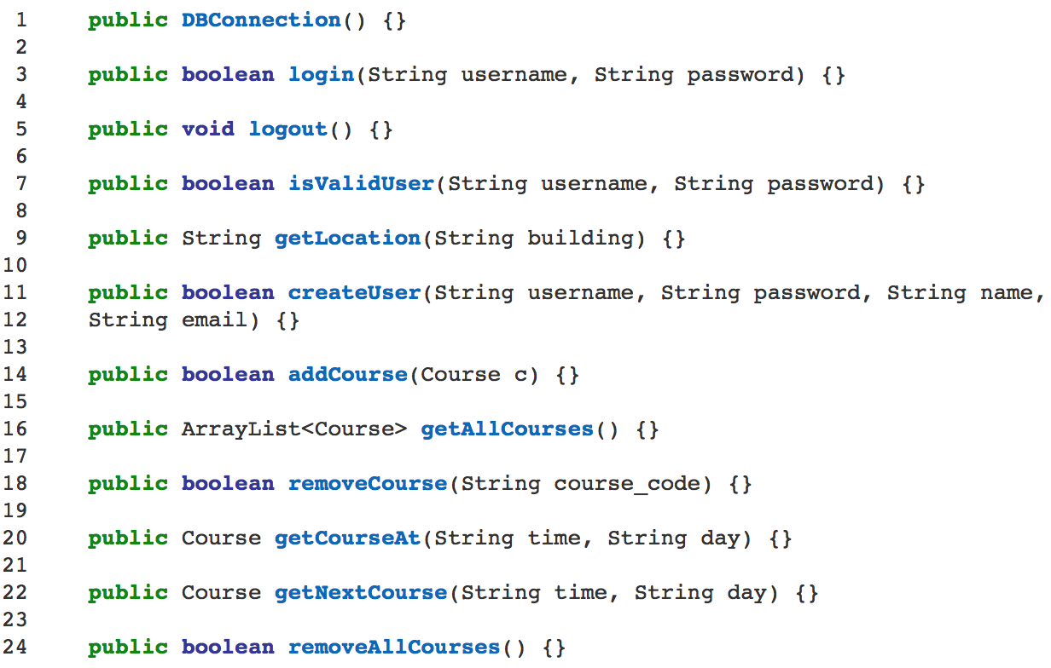
Java API

Slide 6

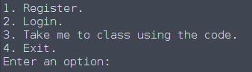
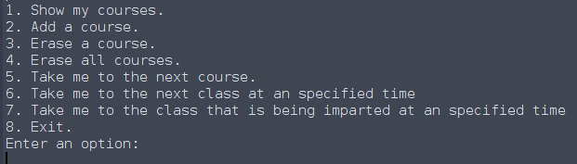

Menu (options)
MAIN
ONE
Second one

Slide 7
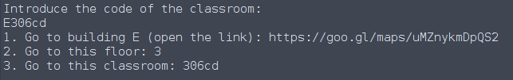


Example

Slide 8


Percentage of completion:
Next steps:
-Android app
-Graphic interface
-Database
-API

Slide 9


Notes:
thanks for your attention

